Slide 1
MULTIPLE ACCESS
UNIT – IV

Slide 2
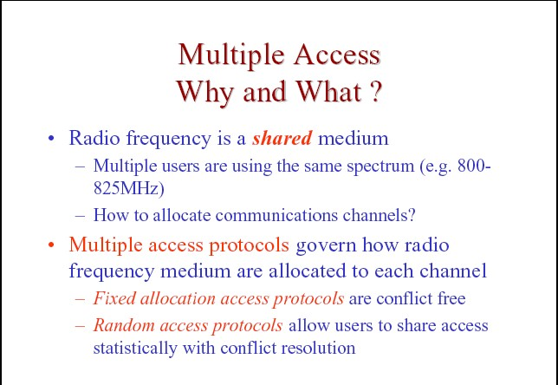

Slide 3
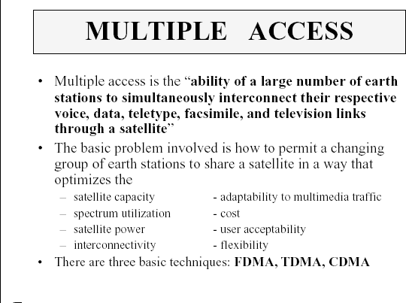

Slide 4
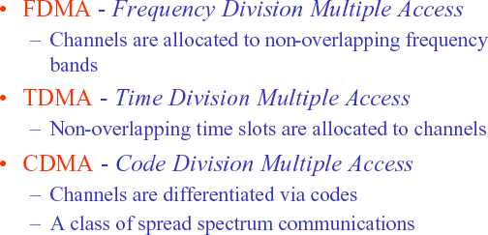

Slide 5
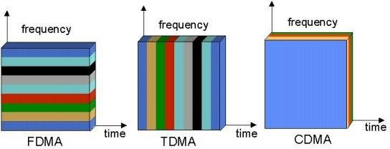

Slide 6
Frequency Division Multiple Access(FDMA):
First multiple access technique used in satellite communication systems.
Available frequency band is divided into N non – overlapping channels.
Guard band minimize interference between channels.
FDM- FM RF carrier is used to transmit data to the satellite.
The main advantage of FDMA is that filters can be used to separate signals.

Slide 7
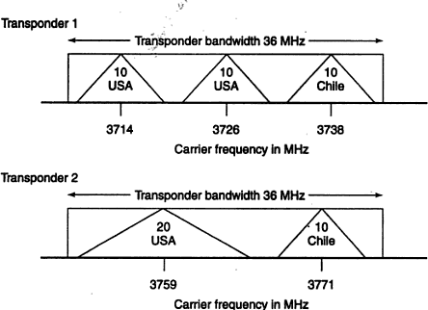

Slide 8
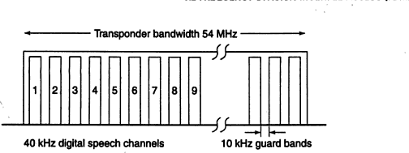

Slide 9
Advantages:
If channel is not in use, it sits idle
Fairly efficient when the number of stations is small and the traffic is uniformly constant
No need for network timing.
No restriction regarding the type of baseband or type of modulation.

Slide 10
Disadvantages:
The presence of guard bands.
Requires right RF filtering to minimize adjacent channel interference.

Slide 11
Intermodulation:
Intermodulation products are generated whenever more than one signal is carried by a nonlinear device.
The characteristics of a transponder can be modeled by a cubic curve to illustrate the generation of third – order intermodulation.
Third – order intermodulation is important because third- order IM products often have frequencies close to the signals that generate the intermodulation.
To illustrate the generation of third- order IM products, we will model nonlinear characteristics of the transponder HPA with cubic voltage relationship and apply two unmodulated carriers at frequencies f₁ & f₂ at the input of the amplifier.

Slide 12
V_{out} = Av_{in} + b(V_{in} )³ where A>>b
⚫
The amplifier input signal is
V₁ cosw₁ t +V₂ cosw₂ t

Slide 13
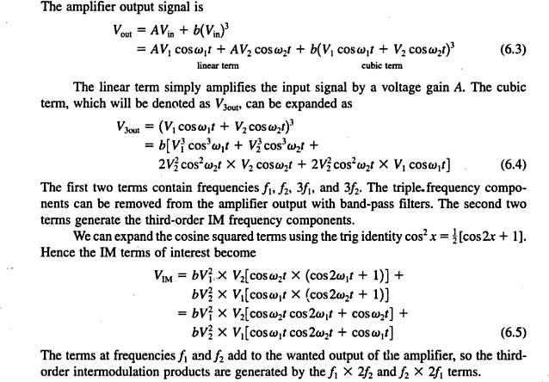

Slide 14
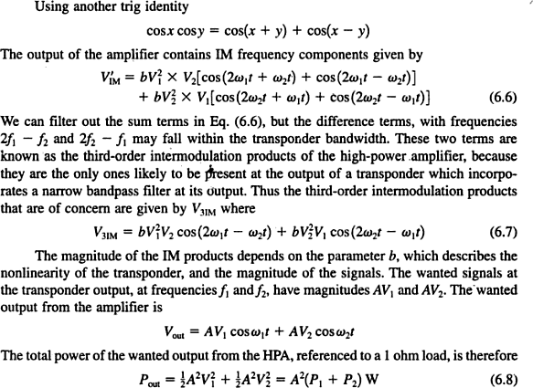

Slide 15
The power of the IM products at the output of HPA is P_{IM} = b² (P₁³ + P₂³ )

Slide 16
Calculation of C/N with intermodulation:
(C/N)_{o} = 1/[1/(C/N)_{up} + 1/(C/N)_{dn} + 1/(C/N)_{IM} ]

Slide 17
Time Division Multiple Access(TDMA):
In TDMA a no. of earth stations take turns transmitting bursts of RF signals through a transponder.
All practical TDMA systems are digital.
TDMA is an RF multiple access technique that allows a single transponder to be shared in time between RF carriers from different earth stations.
The RF carrier from each earth station sharing a transponder is sent as burst at a specific time.
At satellite, bursts from different earth stations arrive sequentially, so transponder carries a near continuous signal.

Slide 18
Time Division Multiple Access:
The time T_{d} available in each station burst for transmission of data bits
T_{d} = [T_{frame} – N(t_{g} + t_{pre} )]/N seconds
In 1 s, the total no. of bits , C_{b} , transmitted by each earth station is
C_{b} = [T_{frame} – N(t_{g} + t_{pre} )]* R_{b} /T_{frame} *N
The no. of speech channel that can be carried by each earth station is n= [T_{frame} – N(t_{g} + t_{pre} )] * R_{b} /(T_{frame} * r_{sp} )*N

Slide 19
Reference Burst
A reference burst is a preamble followed by no traffic bits.
In some systems , a separate reference burst may be transmitted by one of the station, designated as master station.

Slide 20
Synchronization
Earth stations operating in a TDMA network must transmit their RF bursts at precisely controlled times such that bursts from each of the earth stations arrive at the satellite in the correct sequence.
One station is designated as the master station, & may generate a reference burst to mark the start of the frame.(SOTF= Start of transmit frame)
Each of the station within the network has a time slot within the frame and must maintain its transmission within that time slot.
There are guard times at each end of each station’s burst, which define the accuracy that burst timing must achieve.

Slide 21
Satellite switched TDMA
Instead of using a single antenna beam to maintain continuous communication with its entire coverage zone, the satellite has a number of narrow antenna beams that can be used sequentially to cover the zone.
A narrow antenna beam has a higher gain than a broad beam, which increases the satellite EIRP and therefore increases capacity of downlink.
Uplink signals received by satellite are demodulated to recover the bit streams, which are structured as sequence of packets are addressed to different receiving earth stations.

Slide 22
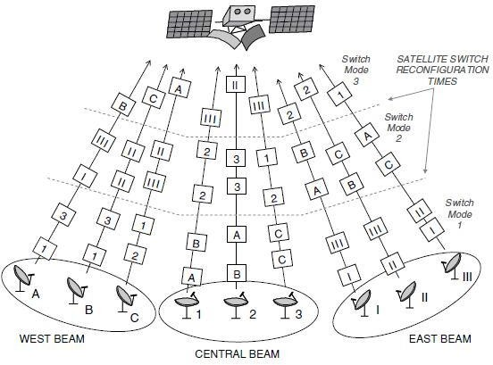
The satellite creates TDMA frames of data that contain packets addressed to specific earth stations, and switches its transit beams to the direction of receiving earth station as packets are transmitted.

Slide 23
Advantages of TDMA
Flexible bit rate
No frequency guard band required
No need for precise narrowband filters
Extended battery life.
The most cost-effective technology for upgrading a current analog system to digital

Slide 24
Disadvantages:
Requires timing synchronization
Demand high peak power on uplink

Slide 25
Onboard Processing:
Generally satellite use bent pipe transponder which simply amplifies a signal received from earth and retransmits it back to earth and retransmits it back to earth.
The disadvantage of the bent pipe transponder is that it is not well suited to uplinks from small earth stations, especially in Ka band.
The solution is baseband processing transponder or onboard processing.

Slide 26
Baseband Processing Transponder
It has a receiver and transmitter similar to those found in an earth station.
The received signal from the uplink is converted to an intermediate frequency and demodulated to recover the baseband signal, which is then processed.
The baseband signal is modulated onto a carrier at downlink frequency and transmitted back to earth.
The advantage of this process is that uplink and downlink signal format need not to be the same and the C/N ratios of the uplink and downlink are not tied together through reciprocal formula.
Separation of the uplink and downlink signals allows different modulation methods to be used, as well as flexible error correction codes.

Slide 27
Demand Access Multiple Access(DAMA):
DAMA can be used in any satellite communication link where traffic from an earth station is intermittent.
Demand access allows a satellite channel to be allocated to a user on demand, rather than continuously, which greatly increases the no. of simultaneous users who can be served by the system.
Most SCPC – FDMA system uses demand access to ensure that the available bandwidth in a transponder is used as fully as possible.

Slide 28
Demand access systems require two types of a channel: a common signaling channel(CSC) and a communication channel.
A user wishing to enter the communication network first calls the controlling earth station using the CSC, and the controller then allocates a pair of channels to that user.
The CSC is operated in RA mode.
The CSC are located at the ends of the transponder bandwidth.
When earth station wants to access the satellite, it transmits a control packet to satellite on the CSC Frequency & waits for a reply.

Slide 29
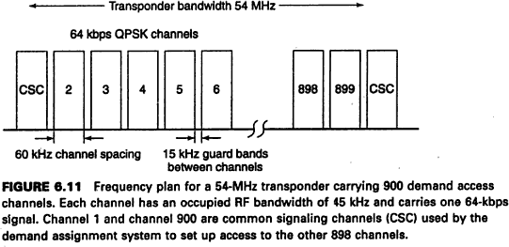

Slide 30
The control packet is received by the hub earth station and decoded.
The control packet contains source addr. & destination addr., also it includes cyclic redundancy check (CRC).
The control station measures duration of the connection in order to generate billing data.

Slide 31
Code Division Multiple Access(CDMA):
CDMA is a scheme in which a no. of users can occupy all of the transponder bandwidth all of the time.
CDMA signals are encoded such that information from an individual transmitter can be recovered by a receiving station that knows the code being used.
Each receiving station is allocated a CDMA code; any transmitting station that wants to send data to earth station must use the correct code.
CDMA codes are typically 16 bits to many thousands of bits in length, and bits of a CDMA are called chips.

Slide 32
CDMA chip sequence modulates the data bits of original message and chip rate is always much greater than the data rate.
This greatly increases the speed of digital transmission.
CDMA is also known as spread spectrum.
Direct sequence spread spectrum (DS-SS) is the only current type used in satellite communication.

Slide 33
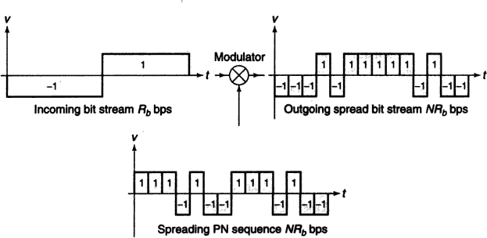
Transmitting Side

Slide 34
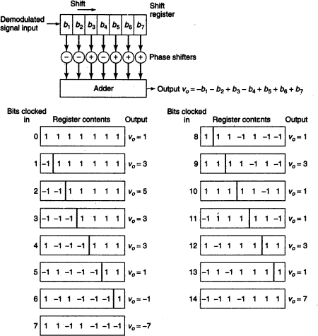

Slide 35
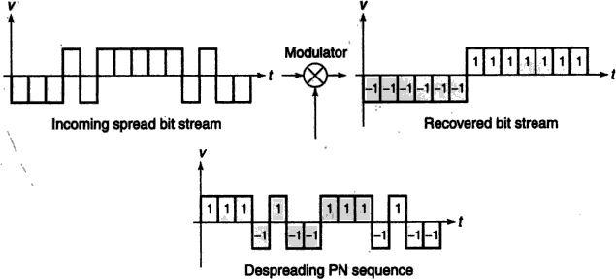
Receiving Side

